Slide 1
Control Algorithm
Notes:
Intros to officers. OFFICERS ARRIVE 15 MINS EARLY

Slide 2
Basics
Develop the software interface between the signals received from the computer system and the ML model
Create an interface that can handle real-time data processing, funneling data from the hardware to the model
Coordinate with the hardware team to manage deployment
Notes:
Josh talk about Bot if finished?

Slide 3
Timeline
2 weeks
2 weeks
2 weeks
2 weeks
4 weeks
1 week
Understanding the Basics
Building on our knowledge
Design
Development
Document and Present
Detailed Requirements Drafting and Prototyping
What core knowledge do you need to cover?
Create an actionable plan for the “how.” How will the control algorithm operate?
Design, validate, build, verify
Document lessons learned, accomplishments, and share your discoveries with The Boring Club and the UW community
How can this knowledge start being applied to the control algorithm?
What will be the exact role of this algorithm? This will include setting up prototypes

Slide 4
Next Steps
Make a copy of the Google doc and use the prompts as a stepping stone for further research
Try to find reliable sources to provide answers for the prompts and other questions and paste them in your copy of the Google doc.
Feel free to add questions as you go

Slide 5
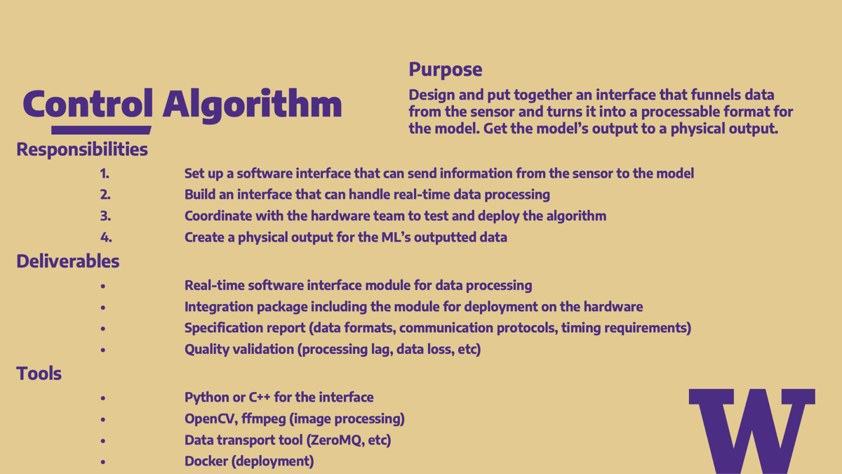

Slide 6
Thanks for coming!

